Slide 1
SemiCon AI Hackathon
Image Restoration Task
30 July, 2026

Slide 2
What is a “Good image”?
Image Degradation
Good Image
Bad Image
Resolution
Blur
Noise

Slide 3
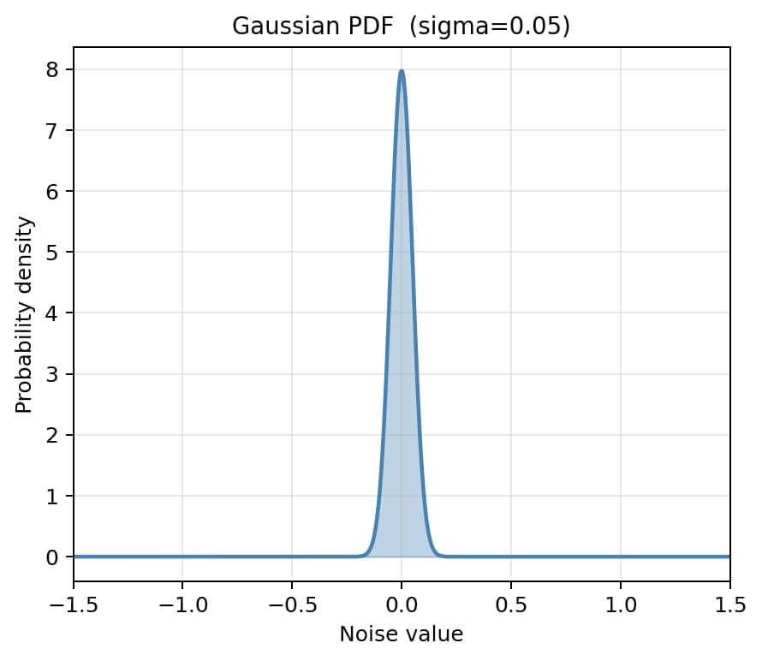
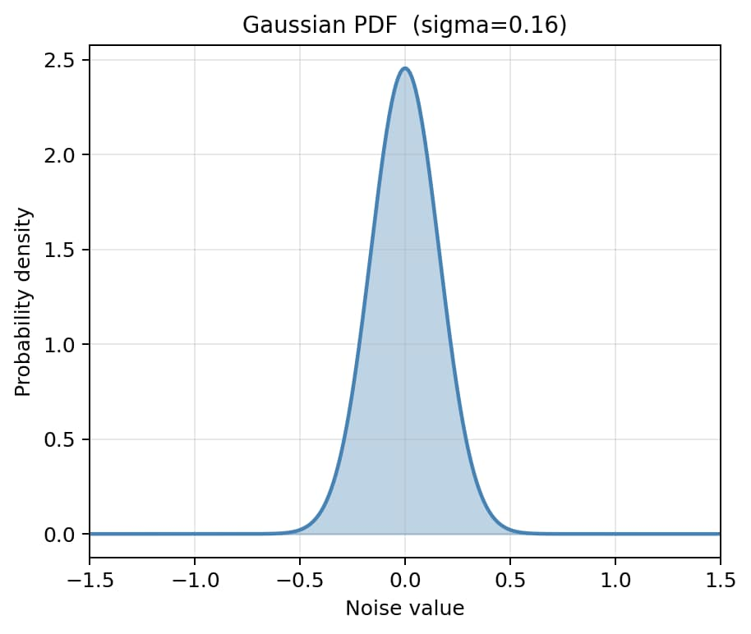
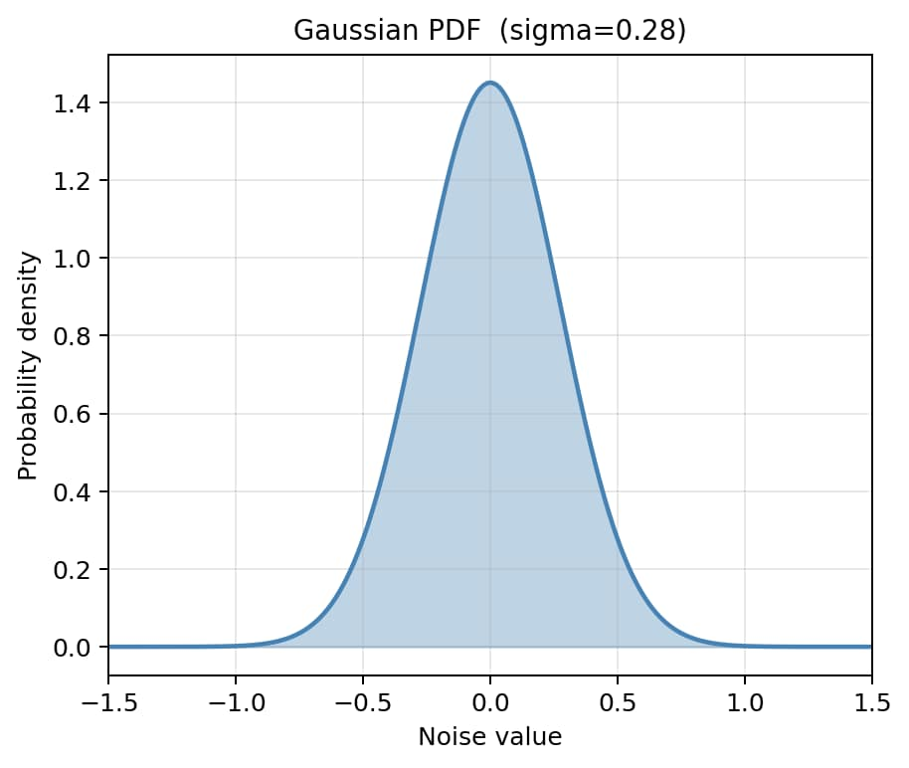
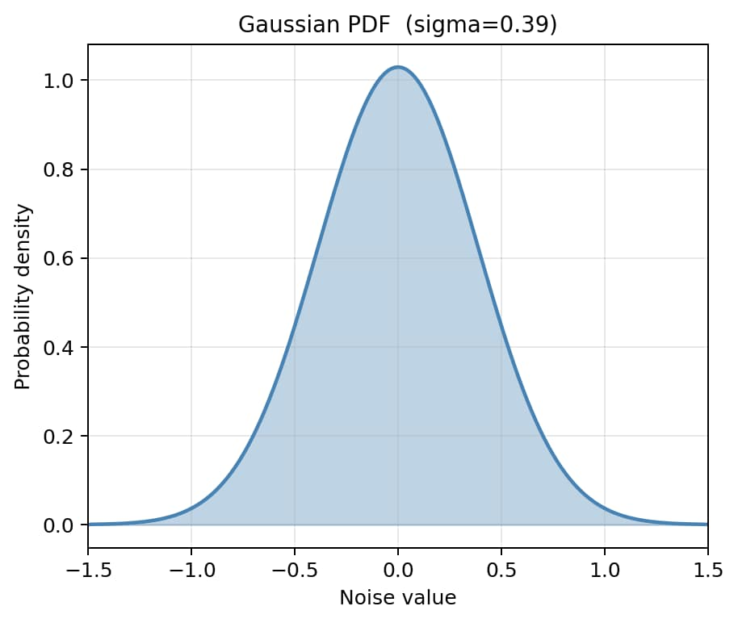
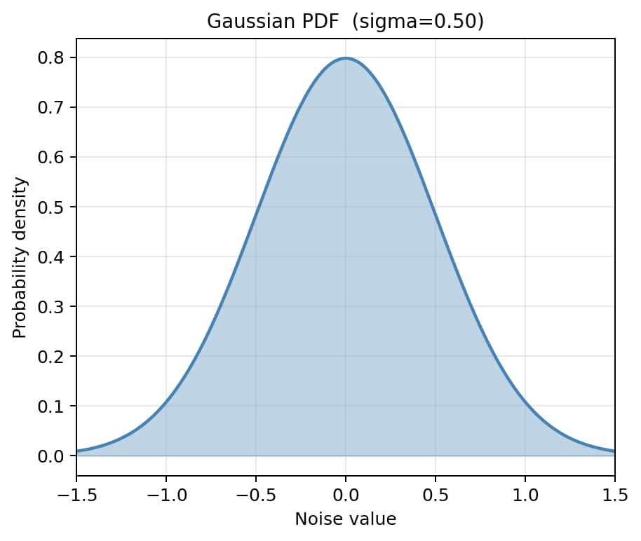
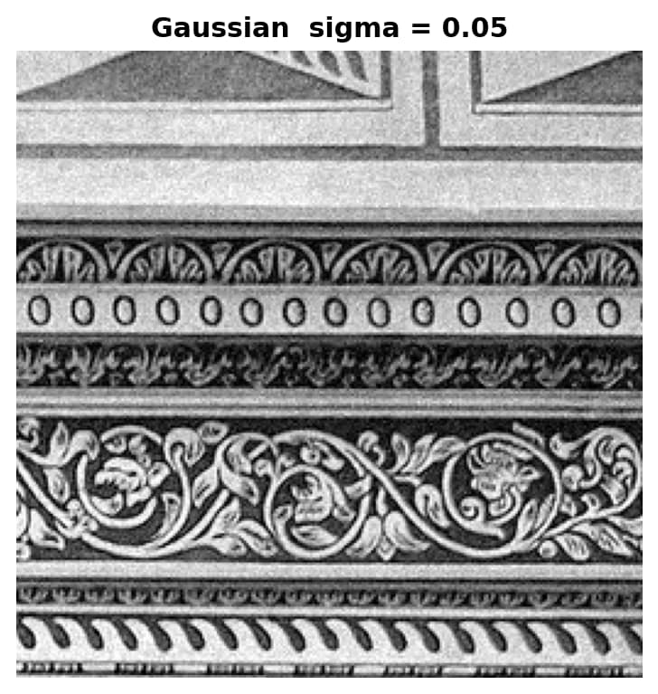
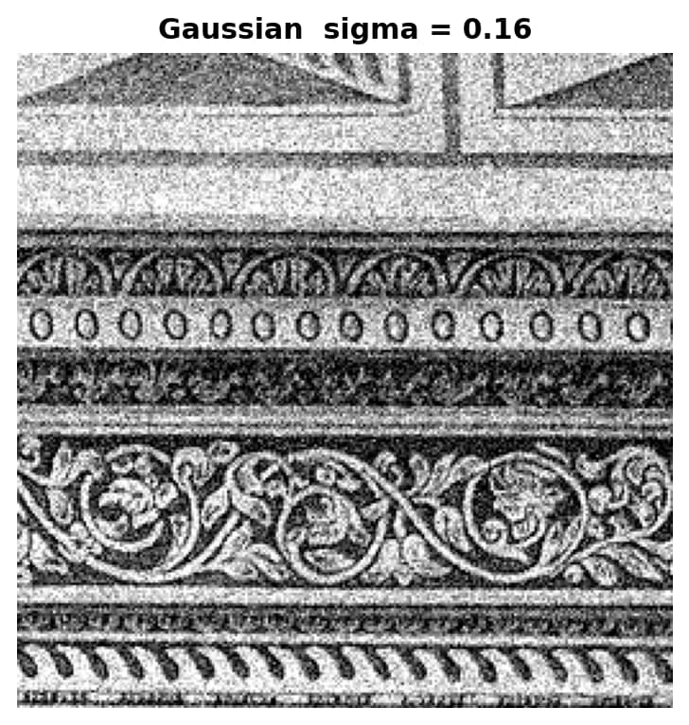
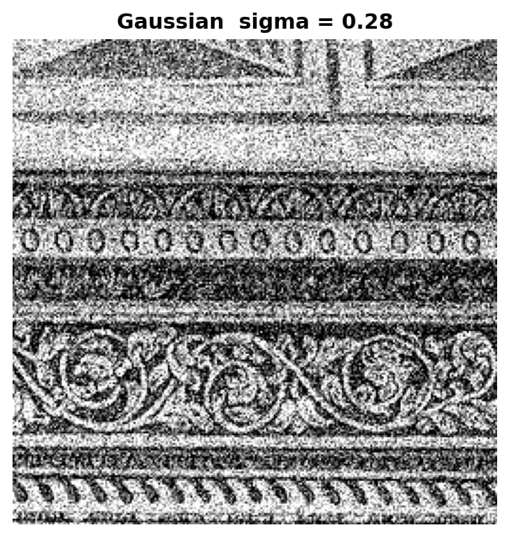
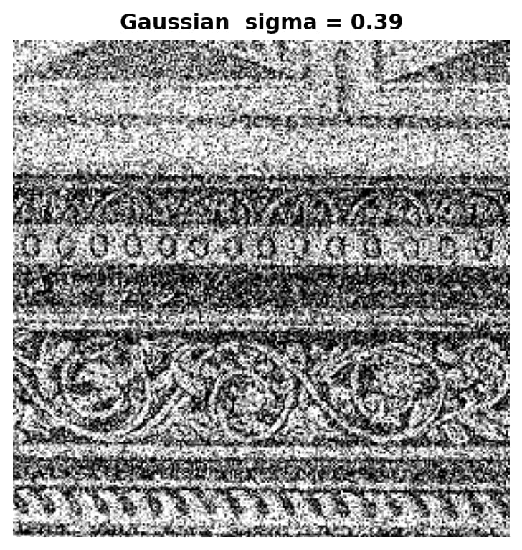
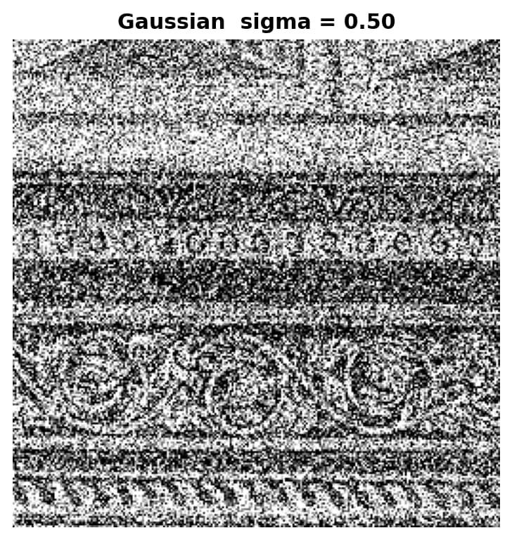
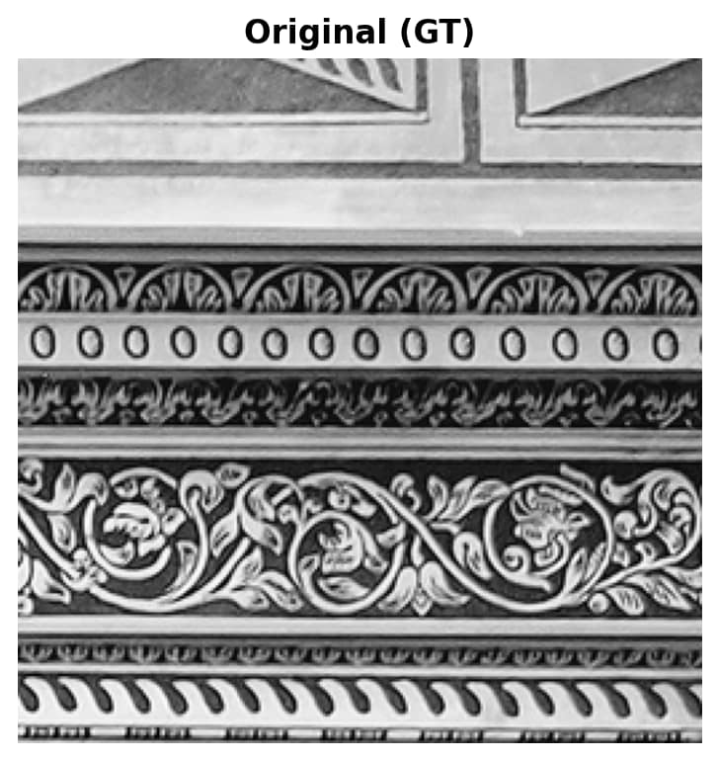
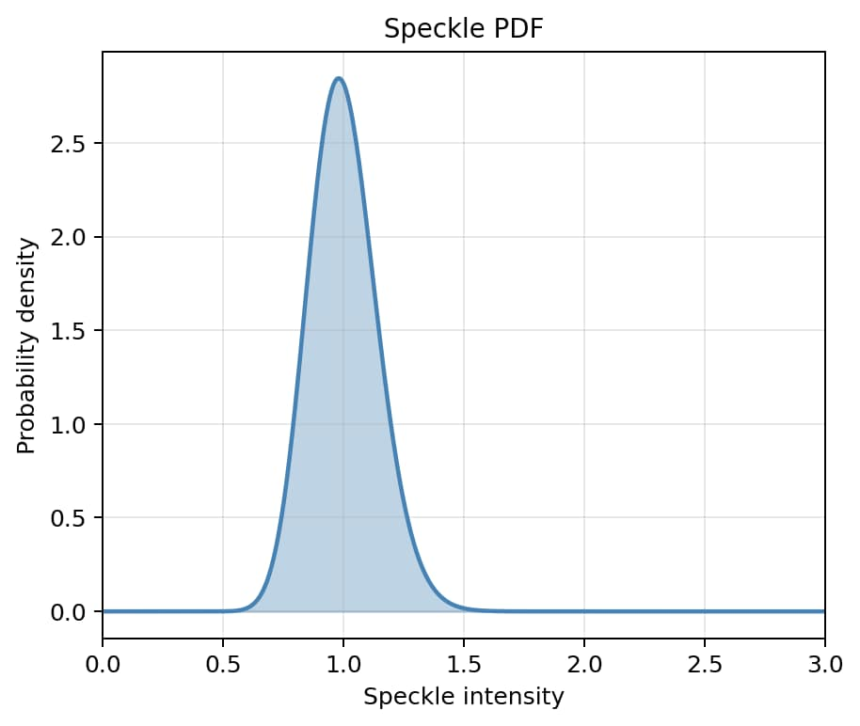
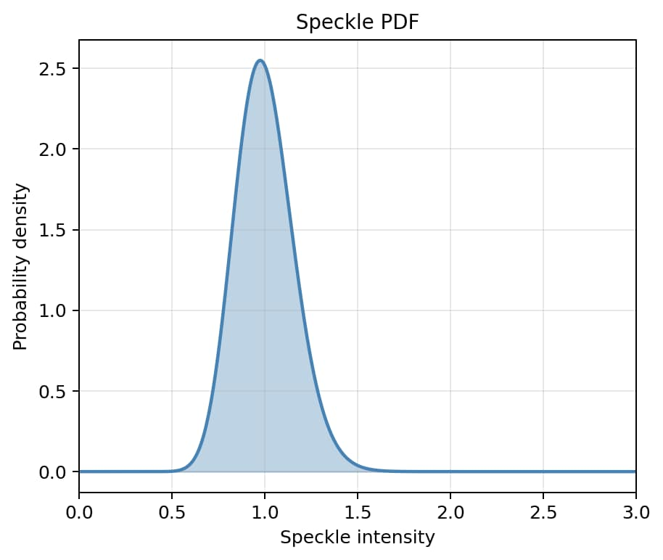
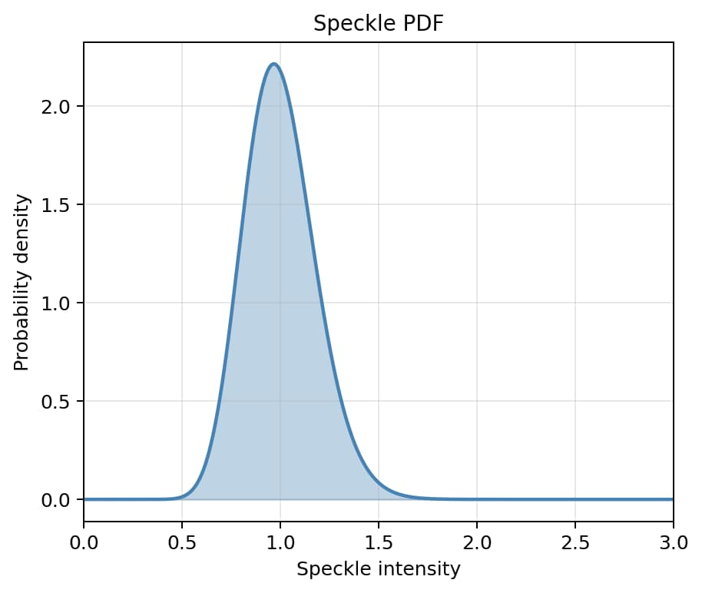
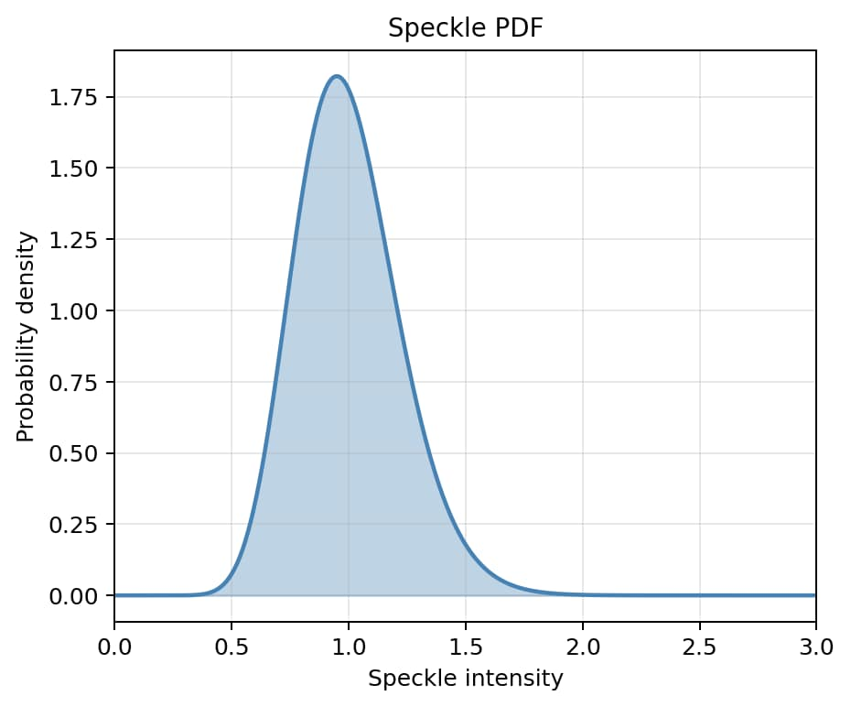
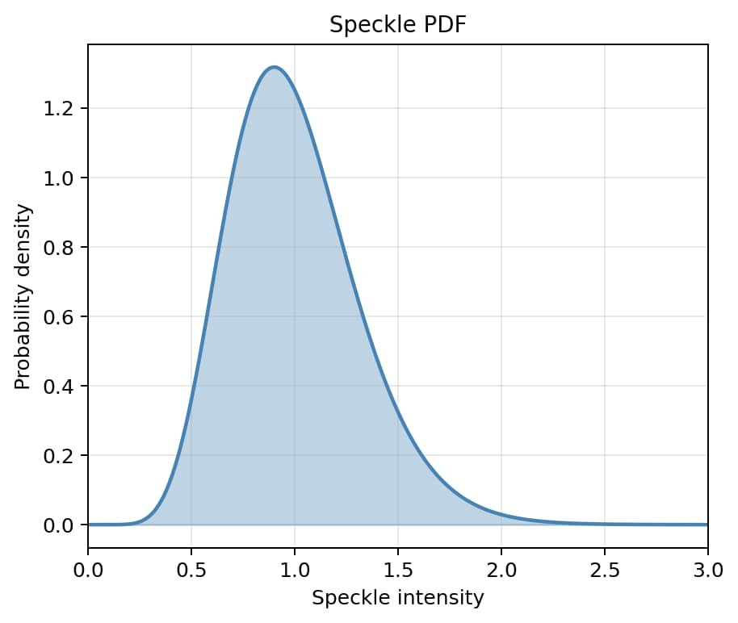
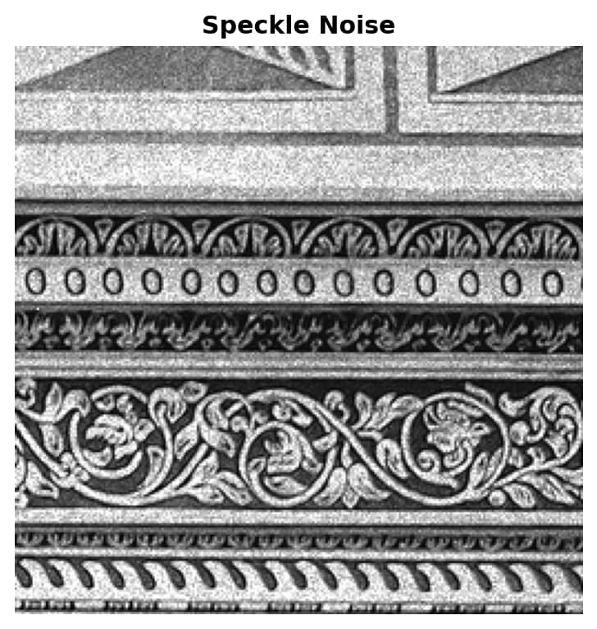

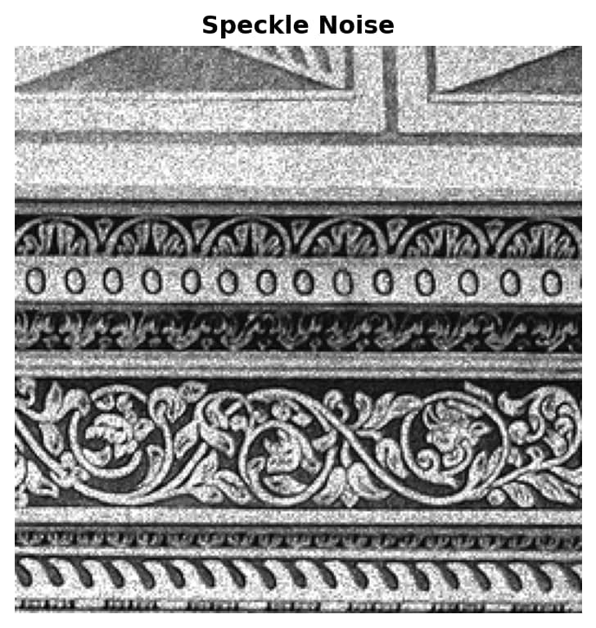
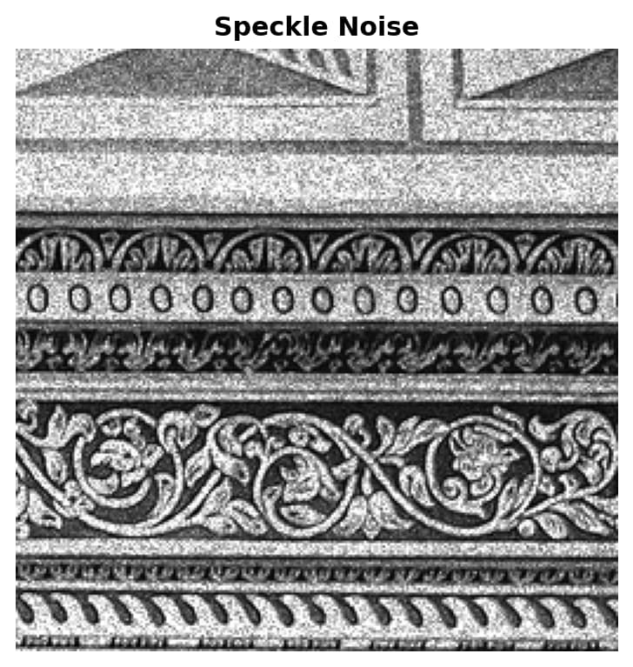
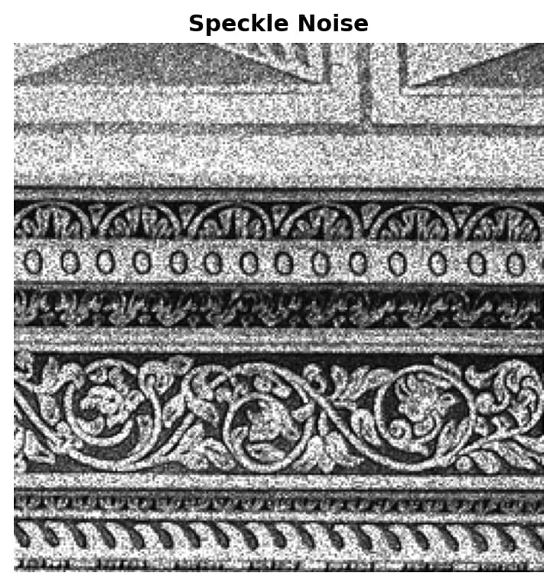
Noise

Slide 4
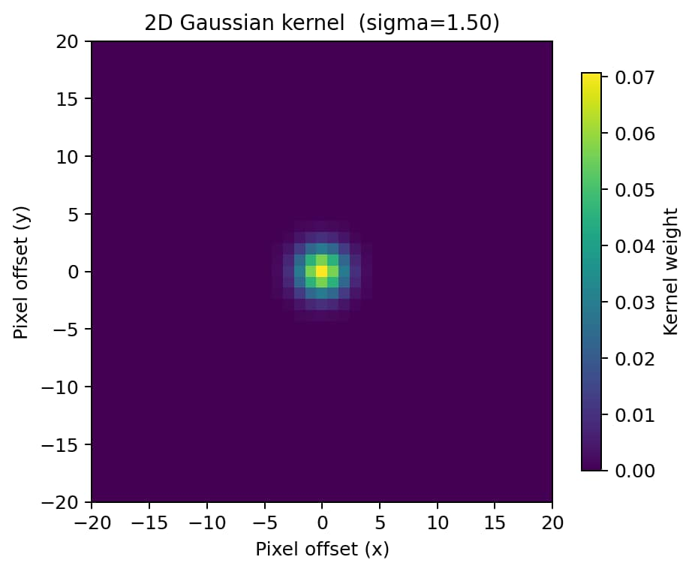
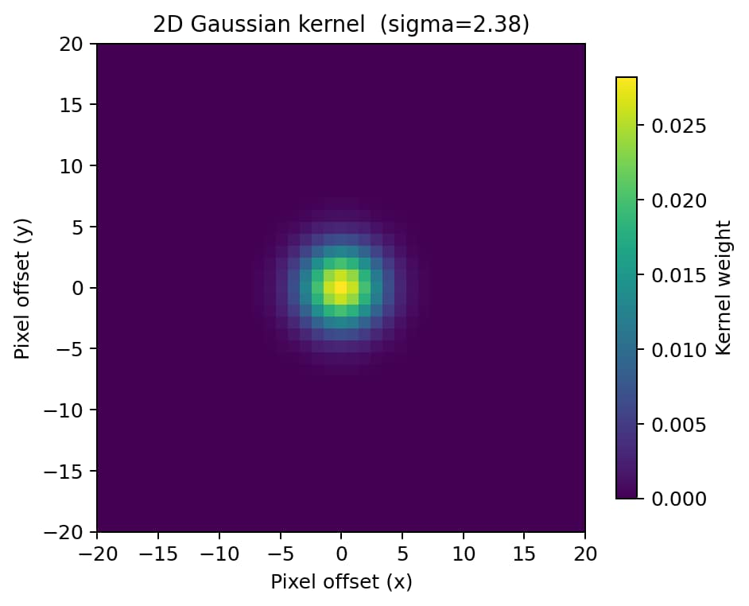
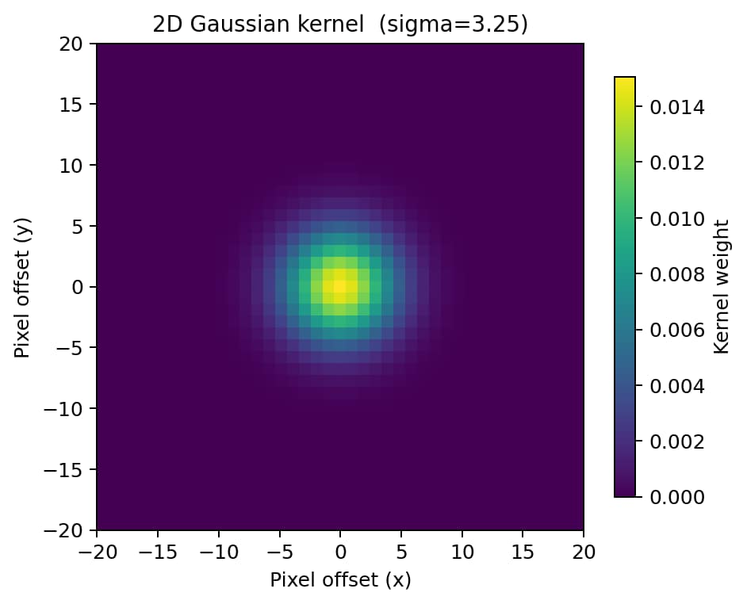
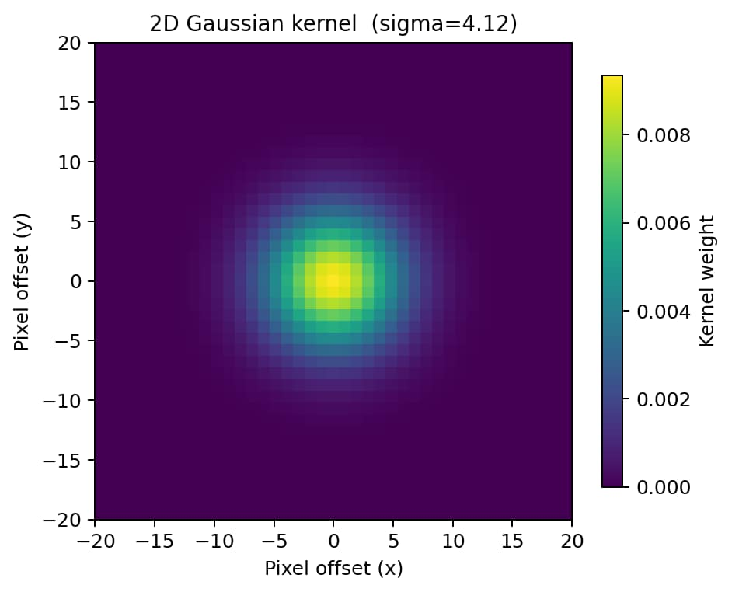
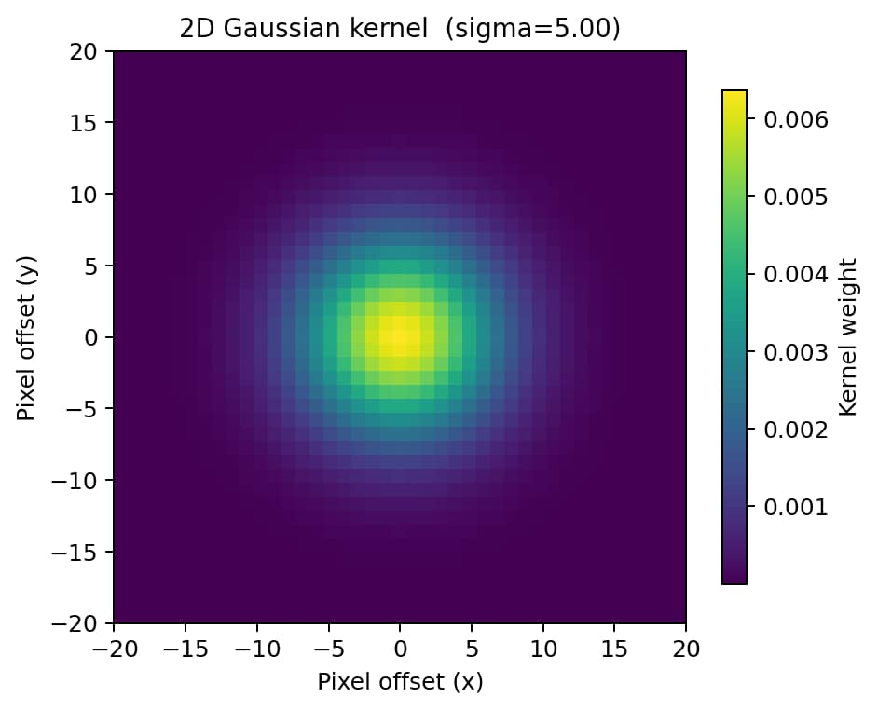
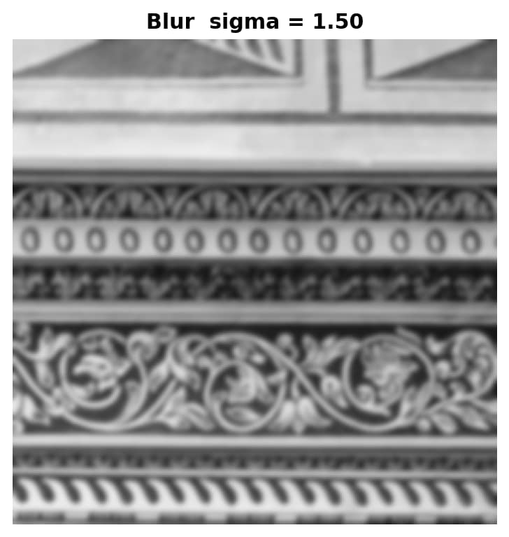
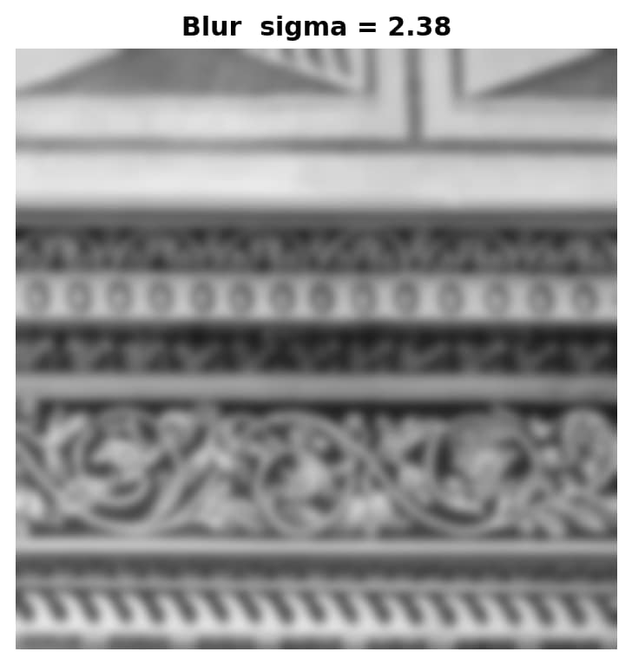



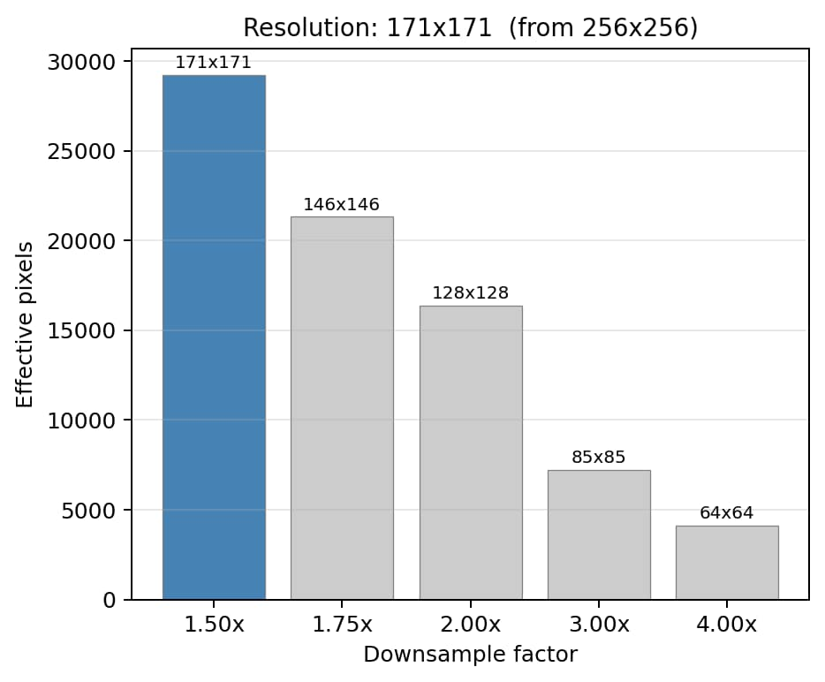
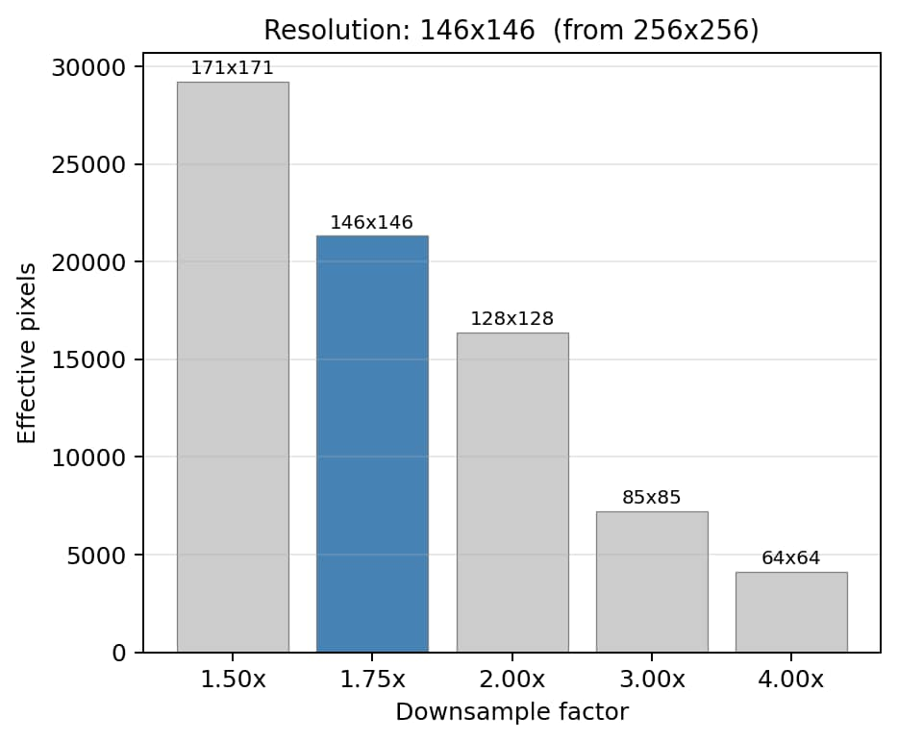
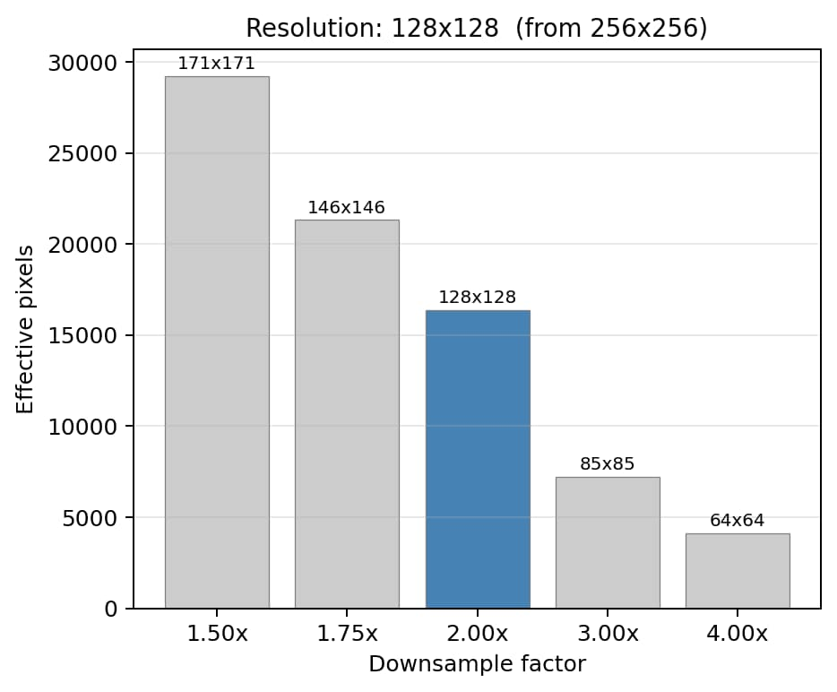
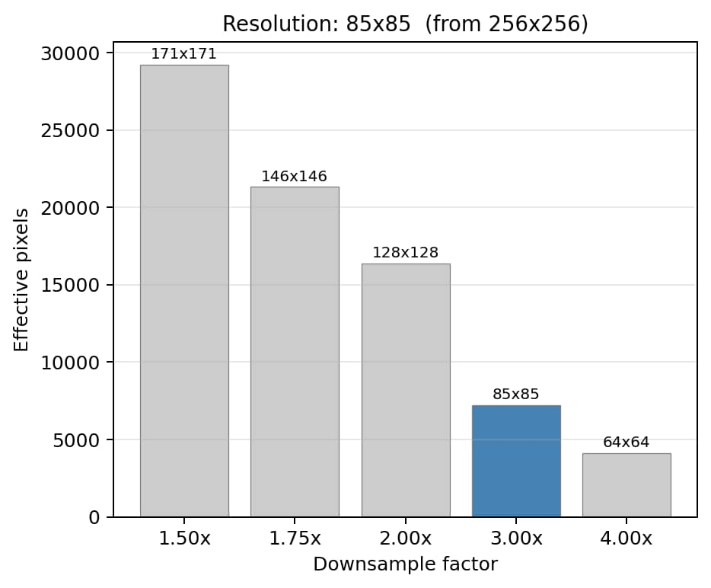
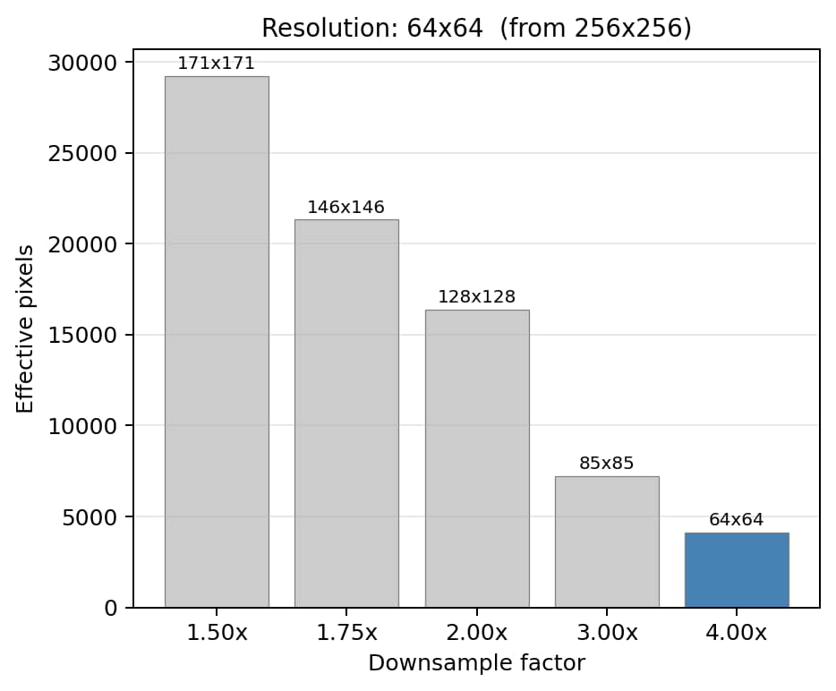





Blur
Resolution

Slide 5
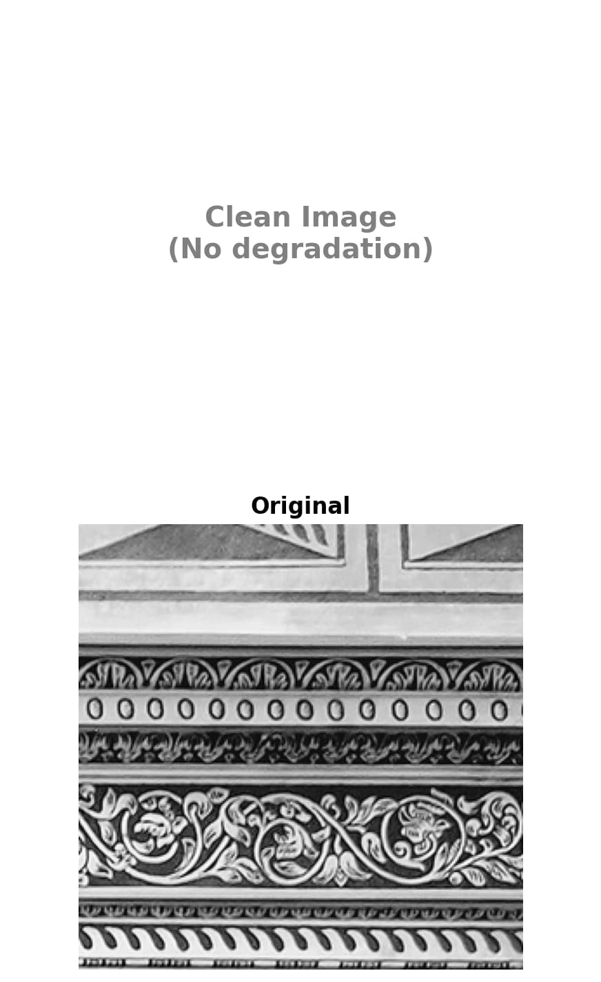
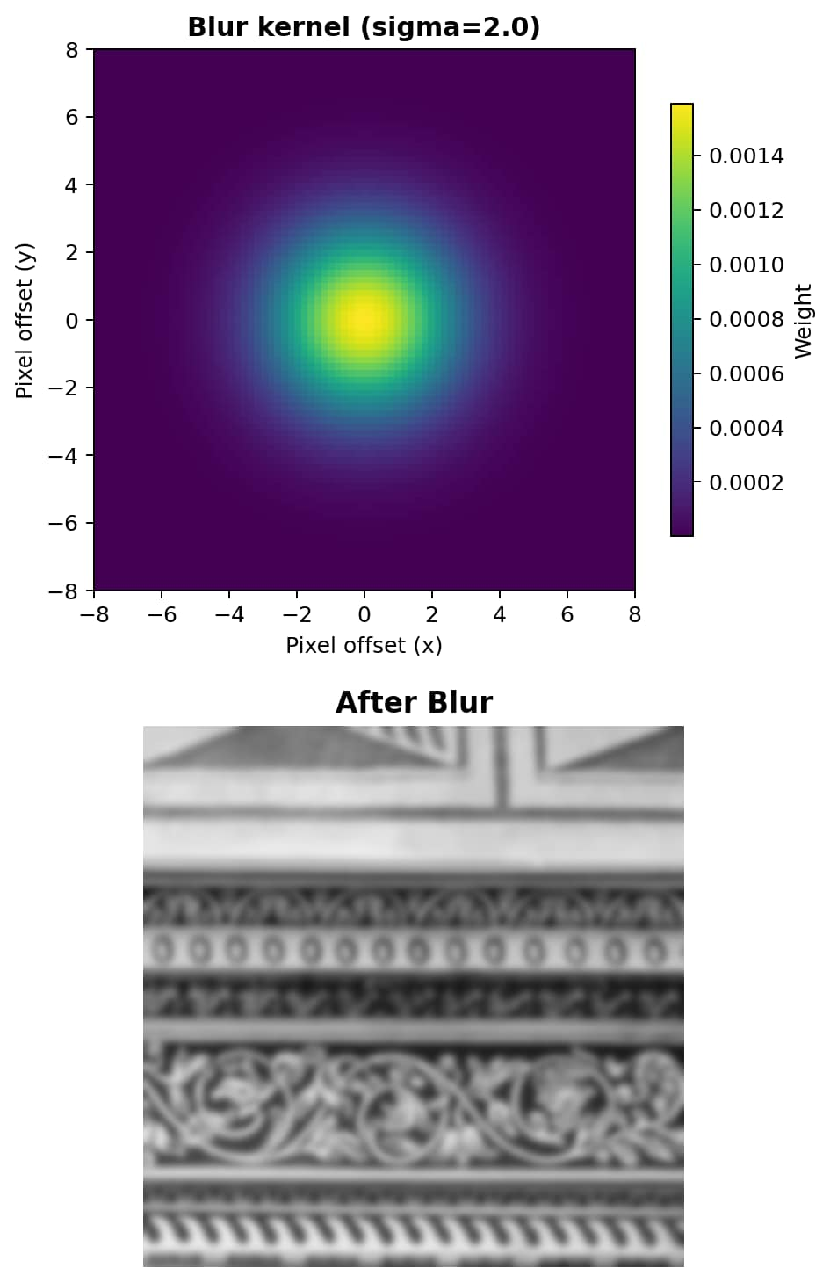
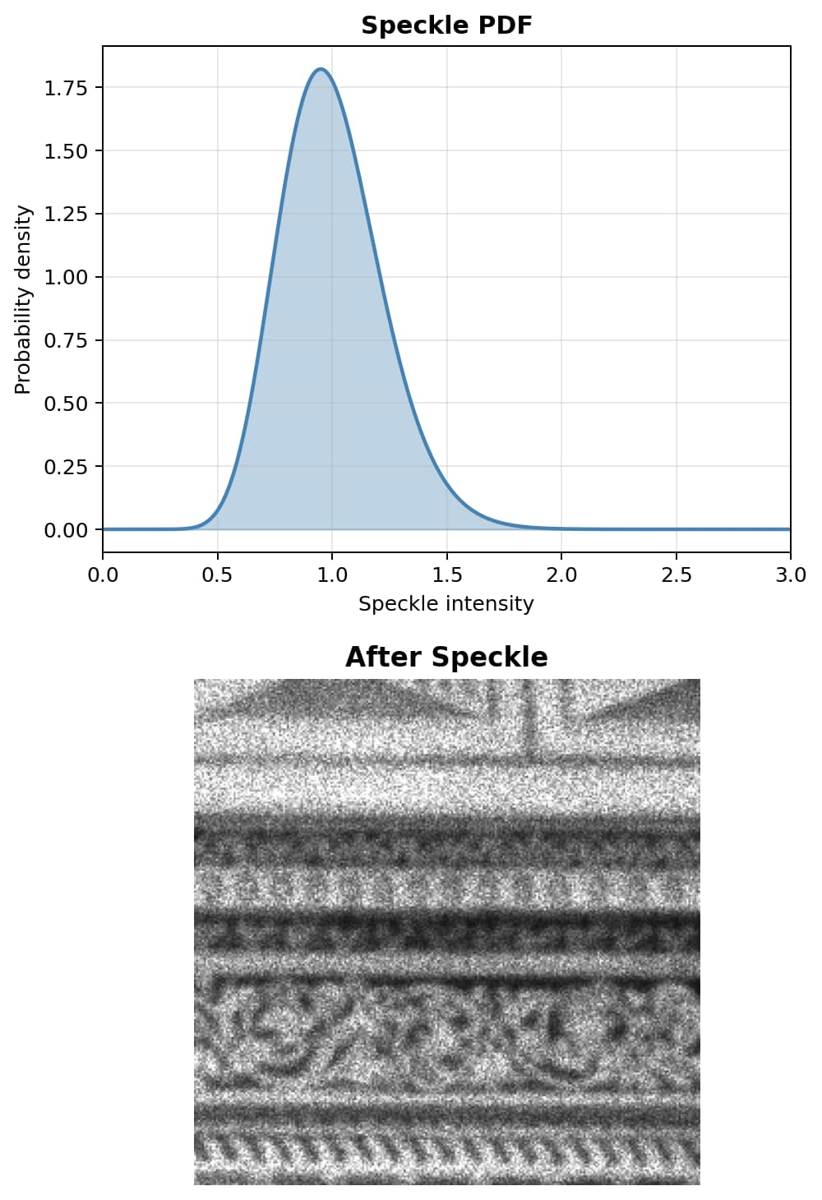
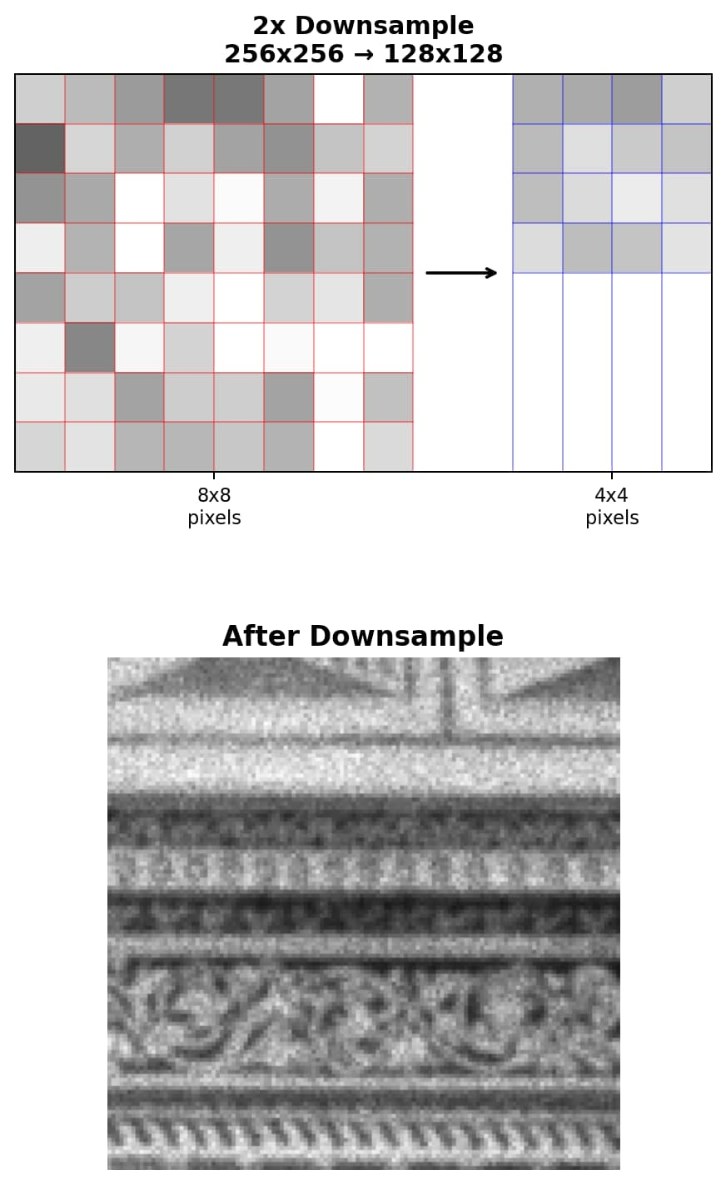
Real world image degradation are more complex
They may appear in any order!

Slide 6
What is the hackathon task?
Not a Trivial Problem ☺
Speckle noise, down-sampling, additive gaussian noise
Do not read into the order of it
Image Degradation
Good Image
Bad Image
Hackathon Task
(learn the transform)
You have this
You need to get this
Need to obtain clean images from degraded images → Image restoration

Slide 7
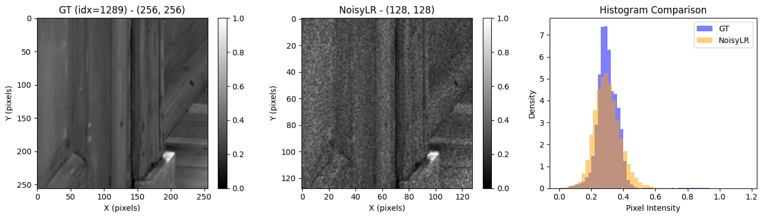
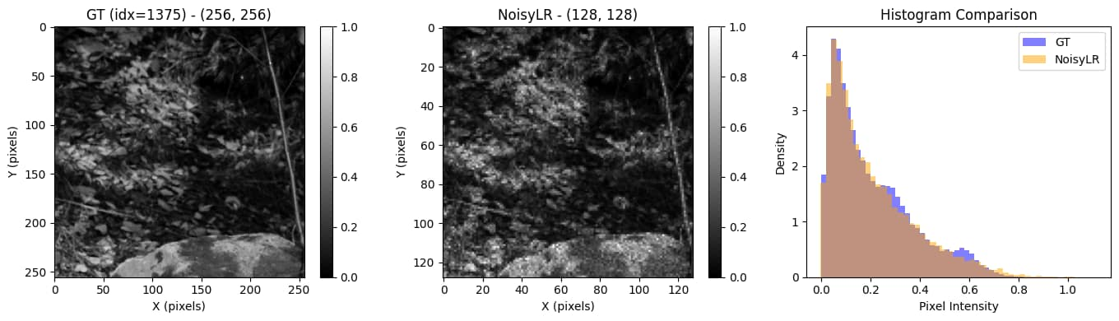
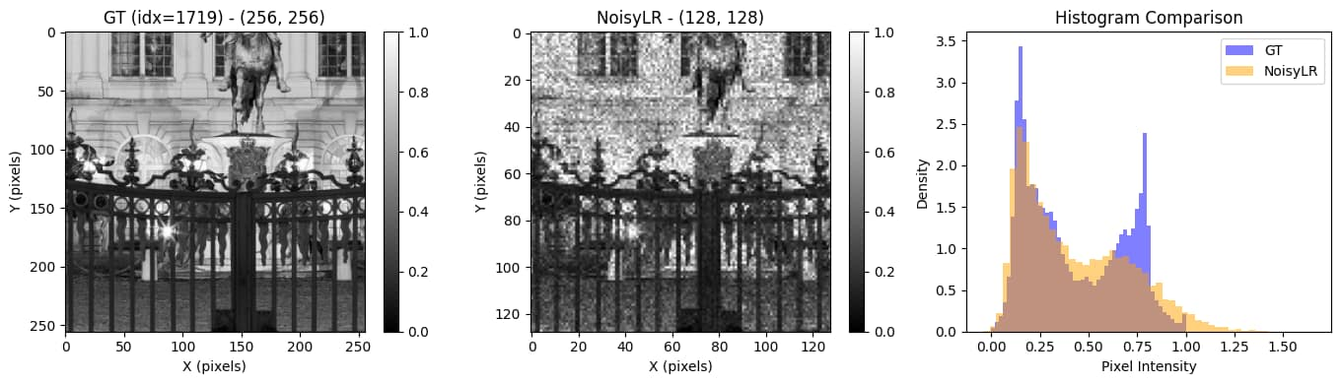
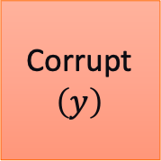
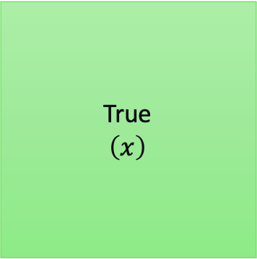
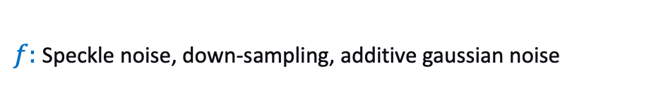

Hackathon Problem
$f:$ Speckle noise, down-sampling, additive gaussian noise
True
$$\left(x\right)$$
$$f:x→y$$
Paired training data
Test data (similar/dissimilar)
Corrupt
$$\left(y\right)$$
A few things to keep in mind:
Image GL ranges: NoisyLR will have value beyond [0,1] whereas GT only has [0,1] – it is a feature not a bug!
Images are normalized a-priori. Welcome to re-normalize. Note that GT is always [0,1].
Hackathon Challenge

Slide 8
While you build the model(s)…
Data¹
AI model²
Loss³
Compute
Evaluations are not just on leaderboard statistics, but also on the emphasis put in each of these blocks.
Computation and Training hygiene is critical!
¹T. Kumar, R. Brennan, A. Mileo and M. Bendechache, "Image Data Augmentation Approaches: A Comprehensive Survey and Future Directions," in IEEE Access, vol. 12, 2024.
²Zhai, Lujun, Yonghui Wang, Suxia Cui, and Yu Zhou. "A comprehensive review of deep learning-based real-world image restoration." Ieee Access 11 (2023): 21049-21067.
³Terven, J., Cordova-Esparza, DM., Romero-González, JA. et al. A comprehensive survey of loss functions and metrics in deep learning. Artif Intell Rev 58, 195 (2025).

Slide 9
Thank You
Questions?

Slide 10
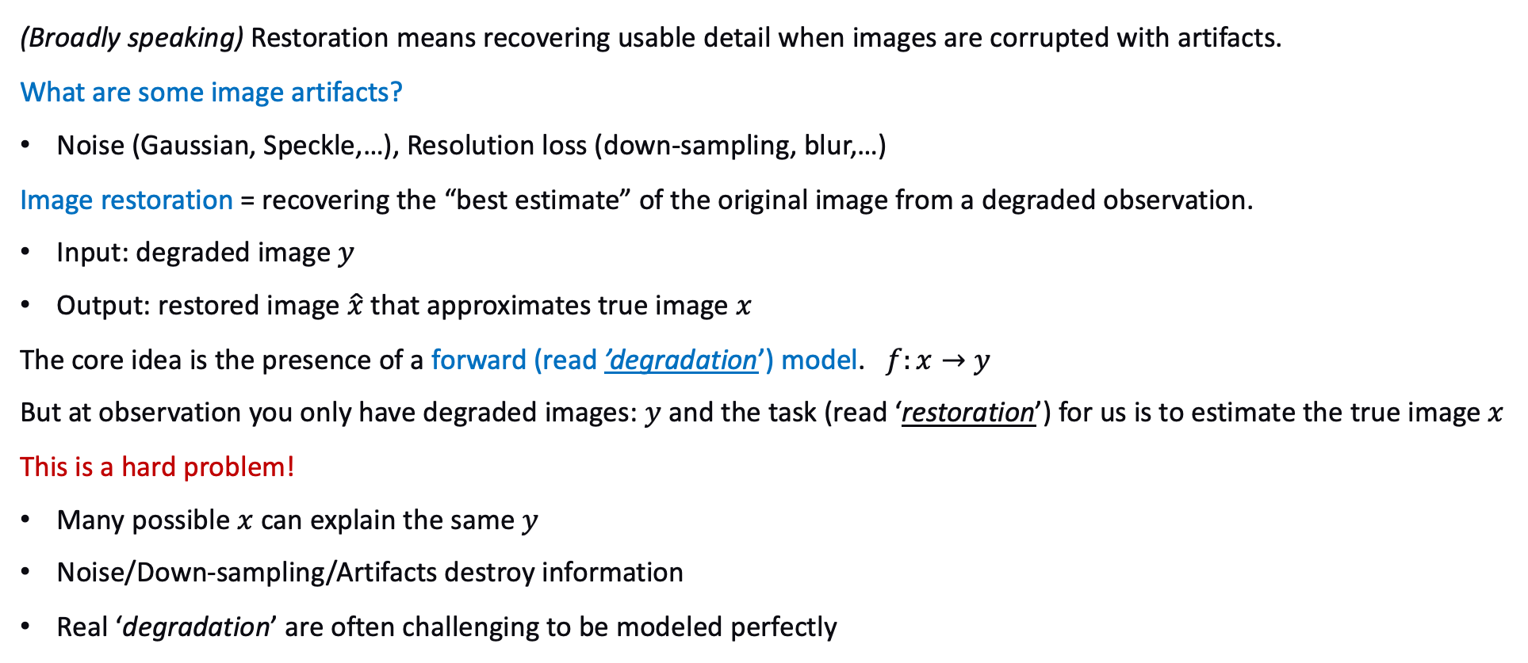
Image Restoration
(Broadly speaking) Restoration means recovering usable detail when images are corrupted with artifacts.
What are some image artifacts?
Noise (Gaussian, Speckle,…), Resolution loss (down-sampling, blur,…)
Image restoration = recovering the “best estimate” of the original image from a degraded observation.
Input: degraded image $y$
Output: restored image $\hat{x}$ that approximates true image $x$
The core idea is the presence of a forward (read ’degradation’) model. $f:x→y$
But at observation you only have degraded images: $y$ and the task (read ‘restoration’) for us is to estimate the true image $x$
This is a hard problem!
Many possible $x$ can explain the same $y$
Noise/Down-sampling/Artifacts destroy information
Real ‘degradation’ are often challenging to be modeled perfectly

Slide 11
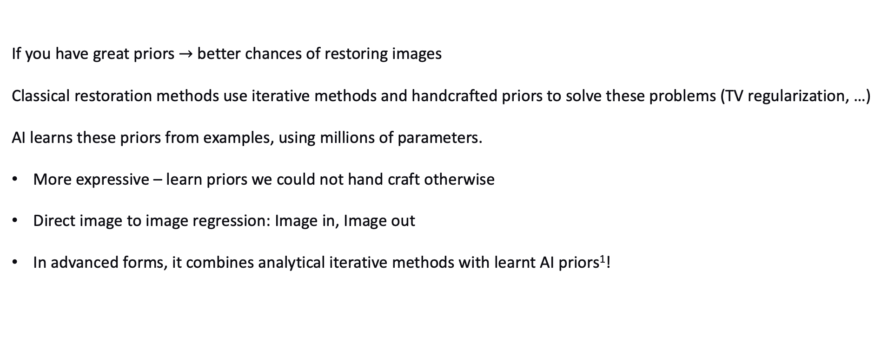
How do we solve these?
If you have great priors $→$ better chances of restoring images
Classical restoration methods use iterative methods and handcrafted priors to solve these problems (TV regularization, …)
AI learns these priors from examples, using millions of parameters.
More expressive – learn priors we could not hand craft otherwise
Direct image to image regression: Image in, Image out
In advanced forms, it combines analytical iterative methods with learnt AI priors¹!
¹V. Monga, et al., "Algorithm Unrolling: Interpretable, Efficient Deep Learning for Signal and Image Processing," in IEEE PM, vol. 38, no. 2, pp. 18-44, March 2021.

